Slide 1
How Economic Development Clients view Our Talent Base
Jung Kim, Columbus 2020
SuccessBound Central Region Conference
February 21, 2019

Slide 2
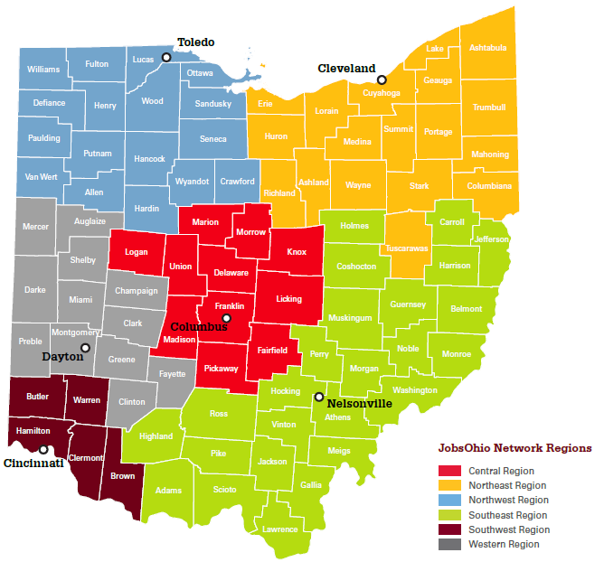
About Columbus 2020
Economic development organization for the 11-county Columbus Region
Network of public and private sector partners
Launched in 2010 to strengthen and diversify economic base:
Build existing assets
Attract new investment
Create new business opportunities
Continually improve Region as a business location

Slide 3



2018 results
58
company announcements
7,887
new jobs committed
$1.53 billion
invested
Notes:
As of 12/31/2018, A/B Projects
2018 marks our best year in terms of number of jobs per project. Number of projects won is declining, but jobs per projects is increasing.

Slide 4
record job growth
Columbus Region employment change (indexed to 100 at start of each decade)
1990 – 1999
2010 – present
2000 - 2009
Source: U.S. Bureau of Labor Statistics, seasonally adjusted by Columbus 2020
Notes:
Through November 2018

Slide 5
Fastest job growth in the Midwest
Private sector job growth from 2010 to 2017, top 10 major Midwest metros
Columbus
Source: U.S. Bureau of Labor Statistics, State and Area Employment, not seasonally adjusted, annual averages
Notes:
Top 10 metros based on population size

Slide 6
Fastest population growth in the Midwest
Population growth from 2010 to 2017, top 10 major Midwest metros
Columbus
Source: U.S. Census Bureau, Population Estimates, 2017
Notes:
Top 10 metros based on population size

Slide 7
Top 10 in U.S. for millennials
Percent of population age 25 to 34, large metro areas (1M+ population)
Columbus
Source: U.S. Census Bureau, American Community Survey 2017

Slide 8
telling the Talent Story: An Inside View

Slide 9
Winning on Talent
Migration between Franklin County and other core counties, 2005 to 2016 (tax exemption flows)
Inbound to Franklin County
Outbound from Franklin County
Source: Internal Revenue Service

Slide 10
Winning on Talent
Percent of recent graduates in Columbus area
Source: LinkedIn data analyzed October 6 of 2016 and 2018, profiles of people who finished school in 2014 or 2015, <2 years of work experience (Oct 2016 snapshot), and those who finished school in 2016 or 2017, <2 years of work experience (Oct 2018 snapshot)

Slide 11
Seasonal Layoffs, Ohio
Seasonal patterns of layoffs offer timing opportunities to find newly available workers.
Source: Bureau of Labor Statistics, Mass Layoff Statistics.
Note: Columbus 2020 produced this analysis for a project in 2017. BLS has since cancelled the MLS program.

Slide 12
Beyond SOC
Machine learning example
BLS/EMSI: possible SOC codes
15-1111 Computer and Information Research Scientists
15-1131 Computer Programmers
15-1132 Software Developers, Applications
15-1133 Software Developers, Systems Software
LinkedIn: keyword search
…"machine learning" OR "deep learning" OR "pattern recognition" OR bayesian OR "artificial neural networks" OR "mathematical optimization" OR "computational learning theory" OR "computational statistics" OR "decision tree learning" OR "association rule learning" OR "support vector machines" OR clustering OR "reinforcement learning" OR "genetic algorithms"…

Slide 13
COLUMBUS Region TECH STACK
Number of LinkedIn profiles in Columbus with software development skills, by language
Source: LinkedIn data analyzed October 10 and 16, 2018.

Slide 14

TALENT
PIPELINE
EDUCATIONAL EXCELLENCE: COMMUNICATION, JOURNALISM, AND LINGUISTICS
The Ohio State University offers more than 800 courses across various departments that feature international content. OSU’s Fisher College of Business is also home to a U.S. Center for International Business and Research (CIBER).
The Ohio State University
Total enrollment: 61,170
Programs include: Communication, Linguistics, Journalism, East Asian Languages, Data Analytics.
International Enrollment: More than 6,700 students from over 100 countries. Top countries include China, India, Korea, Malaysia, Taiwan, Canada, Iran, Turkey, Japan, Saudi Arabia.
Communication and Journalism
#1 Communication Program in the World
(CWUR, 2017)
Required courses include communication research methods, social media analytics and human-computer interaction.
Highlight: Public Affairs Journalism
Teaches students how to investigate and disseminate news with a multimedia focus.
Required courses include data journalism and quantitative reasoning.
Data Analytics
State-of-the-art undergraduate data analytics program currently enrolls 140 students in major program and 217 in the pre-major.
The Computational Analytics specialization includes various possible focus areas: linguistics and text analytics, machine learning, graph analytics, visual analytics and cybersecurity.
Highlight: DataFest™, American Statistical Association
Undergraduate student teams work over the course of a weekend to interpret, analyze and draw insights from a dataset provided by a major company.
At the end of the weekend, teams present their analyses to a panel of judges. Datasets previously provided by Ticketmaster, Expedia and Indeed.com.
Linguistics
#8 Linguistic Program in the World
(CWUR, 2017)
Offers computational linguistics specialization with required coursework in quantitative and logical skills, including mathematical and data analysis.
Highlight: Ohio Supercomputer Center (OSC)
Ohio State’s linguistics students and professors partner with the Columbus-based OSC on the development of computer algorithms and statistical grammar techniques to translate news text in lesser known languages.
Foreign Language
30 languages offered through more than 600 courses
Highlight: Chinese Language Program
Consists of 70 undergraduate majors, 50 undergraduate minors, and one of the largest U.S. graduate programs.
Sources: The Ohio State University, Columbus 2020.

Slide 15







TALENT
PIPELINE
EDUCATIONAL EXCELLENCE: COMMUNICATION, JOURNALISM, AND LINGUISTICS (CONTINUED)
Ohio University
Total Enrollment: 20,815
Programs include: Communication, Journalism, Linguistics, Business Analytics
International Enrollment: More than 1,300 students from over 100 countries.
Communication and Journalism
Scripps School of Journalism:
Top 10 journalism school in the U.S.
Designated an Ohio Board of Regents Center of Excellence for the quality of its 200+ annual graduates.
B.S. Journalism in two tracks: News & Information and Strategic Communication. Core coursework in data journalism, multiplatform reporting and writing, and specialized business media.
Institute for International Journalism:
Prepares students to work as international journalists and supports related research.
Oversees foreign correspondence internships with the Associated Press in Rome, London, Paris, Amsterdam, Caracas and Jerusalem.
J. Warren McClure School of Information and Telecommunication Systems:
Educates students about the design, management, and uses of communication technologies. Unique coursework focuses on the business applications of voice and data networks and services.
Data Analytics
Social Analytics Consortium (SAC)
As a founding member, helped lead partnerships of universities that have analytics labs and centers focused on social media research.
The Forensics Team has won three team championships and 16 top-ten finishes in National Forensics Association tournaments.
Highlight: Social Media Analytics Research
Team (SMART) Lab
Provides students and faculty the ability to research the impact of social media surrounding specific events or organizations.
Linguistics and Foreign Language
Undergraduate B.A. and minor in Linguistics and M.A. in Applied Linguistics. Areas of concentration include a four-course module in computer-assisted language learning.
Specialized language training in English as a Second Language, Arabic, Chinese, Japanese and Swahili.
OTHER NOTABLE INSTITUTIONS OFFERING COMMUNICATIONS AND JOURNALISM DEGREES
Sources: Ohio University; Columbus 2020.

Slide 16
TALENT
PIPELINE
COLUMBUS REGION IT TALENT PIPELINE
The Columbus Region’s higher education and career training centers produce 1,500 annual IT completions.
COMPUTER SCIENCE AND SOFTWARE RELATED PROGRAMS BY DEGREE LEVEL IN THE COLUMBUS REGION
INSTITUTION | VOC/TECH | ASSOCIATE | BACHELOR | GRADUATE
THE OHIO STATE UNIVERSITY
FRANKLIN UNIVERSITY
DEVRY UNIVERSITY
CAPITAL UNIVERSITY
OTTERBEIN UNIVERSITY
OHIO DOMINICAN UNIVERSITY
MT. VERNON NAZARENE UNIVERSITY
DENISON UNIVERSITY
OHIO WESLEYAN UNIVERSITY
KENYON COLLEGE
INDIANA WESLEYAN UNIVERSITY
COLUMBUS COLLEGE OF ART & DESIGN
PARK UNIVERSITY
COLUMBUS STATE COMMUNITY COLLEGE
OHIO BUSINESS COLLEGE
CENTRAL OHIO TECHNICAL COLLEGE
MARION TECHNICAL COLLEGE
OHIO UNIVERSITY - LANCASTER
TRI-RIVERS CAREER CENTER
KNOX COUNTY CAREER CENTER
EASTLAND FAIRFIELD CAREER SCHOOL
TECHNICAL SKILLS COLUMBUS
TOLLES CAREER & TECHNICAL CENTER
C-TEC
Source: College websites; National Center for Education Statistics; degree completions 2015-2016..

Slide 17
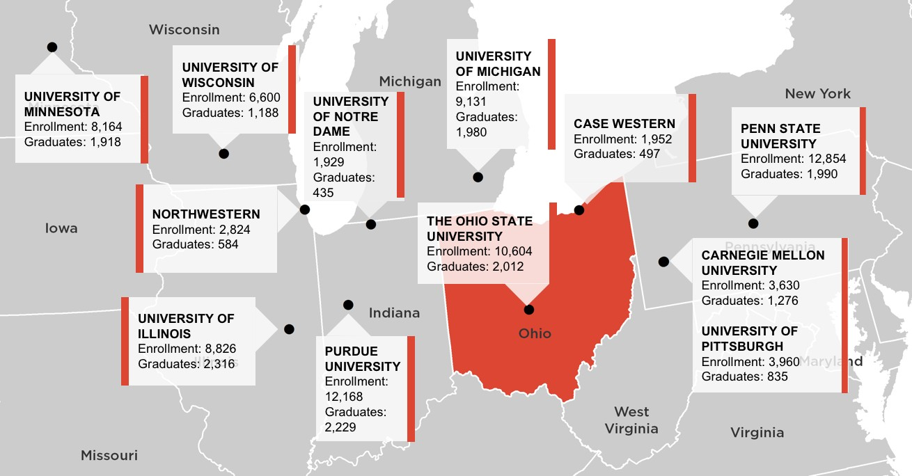
TALENT
PIPELINE
COLUMBUS: AT THE HEART OF THE MIDWEST IT TALENT PIPELINE
The nation’s top IT talent chooses the Midwest. Twelve of the top 50 ranked graduate engineering programs are in the Midwest, cumulatively graduating 20,000 bachelor’s and master’s degree recipients annually.
Source: U.S. News & World Report, 2017 Best Graduate Engineering Programs; National Center for Education Statistics; Columbus 2020

Slide 18
TALENT
PIPELINE
COLUMBUS REGION DESIGNATED STEM SCHOOLS
Name | City | Total Enrollment | Distance (miles) to Downtown Columbus
Linden-McKinley STEM Academy | Columbus | 1,179 | 4.5
West High School | Columbus | 872 | 4.3
Metro Early College High School | Columbus | 699 | 4.7
Reynoldsburg High School eSTEM | Reynoldsburg | 653 | 16.9
Reynoldsburg High School | Reynoldsburg | 496 | 11.7
Marysville STEM Early College High School | Marysville | 391 | 34.3
Baldwin Road Junior High School | Reynoldsburg | 583 | 11.7
Pickerington Ridgeview Junior High School | Pickerington | 905 | 16.8
Canal Winchester Middle School | Canal Winchester | 901 | 16.7
Herbert Mills Elementary | Reynoldsburg | 422 | 11.7
Summit Road Elementary | Reynoldsburg | 493 | 16.9
New Hope Christian Academy | Circleville | 224 | 27.3
Source: Ohio STEM Learning network, designated STEM schools located in the Columbus Region; Ohio Department of Education, 2017 school building total enrollment.

Slide 19
Envisioning the
Future workforce

Slide 20
Growing Diversity
Franklin County population by age and race/ethnicity
Source: Census Bureau, Decennial Census 2010, Population Estimates 2015

Slide 21
Global Business
U.S. exports, 1960-2017
U.S. companies exported
$2.3 trillion in goods and services in 2017
Source: Census Bureau

Slide 22
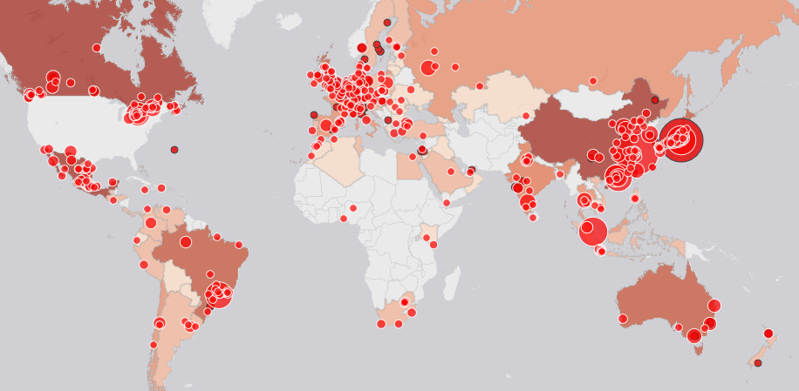
Columbus global reach
HQ, key locations and export markets of Columbus Region firms
Source: Columbus 2020

Slide 23
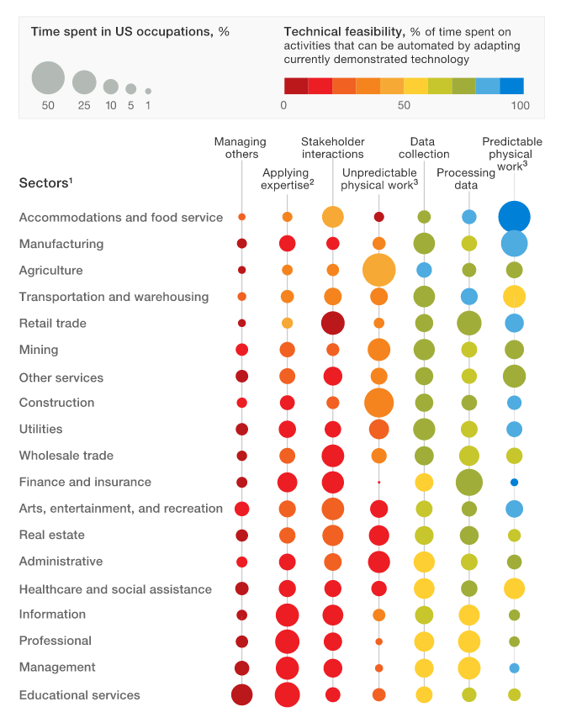
New jobs
where machines can impact jobs
Five factors for automation
1 – Technical feasibility
(is it automatable?)
2 – Costs to automate
3 – Relative scarcity of labor
4 – Skills
5 – Costs of workers
Source: “Where machines could replace humans—and where they can’t (yet)”, McKinsey Quarterly, July 2016

Slide 24

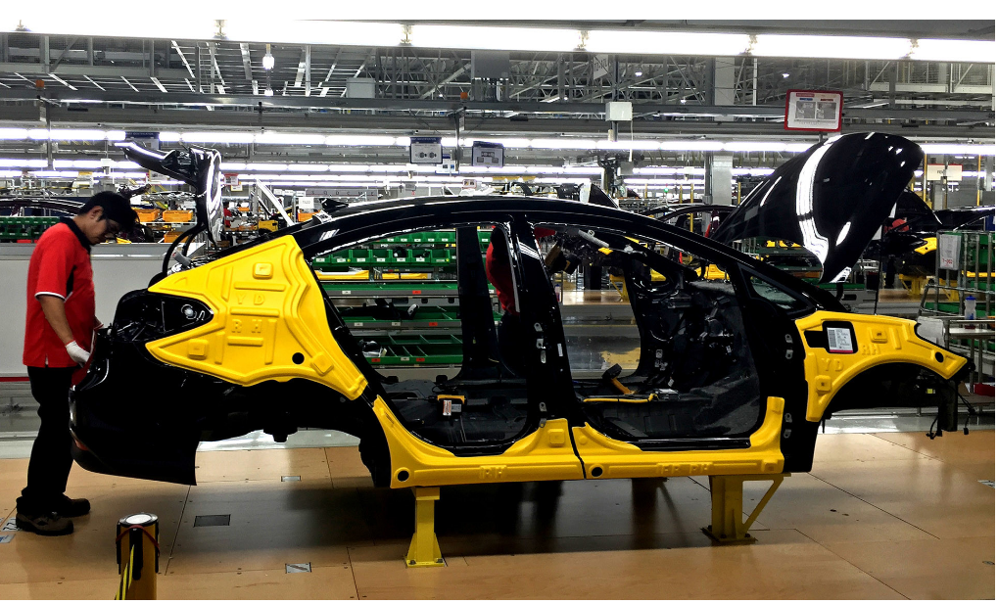
New jobs
CEOs surveyed on impact of AI and robotics on jobs
Job
loss
Despite fears, Mexico’s manufacturing boom
is lifting U.S. workers
Automation manager at Wisconsin plant who started career at $5.50/hour:
“The robots do my [old] job, and I am managing people that manage them.”
Gain or no loss:
retrain people to use technology or redesign jobs to better take advantage of human skills
Source: 2017 Deloitte Global Human Capital Trends

Slide 25
Manufacturing Innovation
Columbus Region output versus employment (indexed to 100 in 2001)
$12.2B
“In 1980 it took 25 jobs to generate $1 million in manufacturing output in the U.S. Today it takes five jobs.”
(“Manufacturing jobs aren’t coming back”, MIT Technology Review, November 18, 2016)
$10.5B
113K
86K
Sources: Moody’s Economy.com (output in 2009 USD); EMSI

Slide 26
Upskilling Workforce
Percent of adults age 25+ with bachelor’s degree or higher, 1980-2010
Source: Census 1980-2000, American Community Survey 2008-2010

